Slide 1



SMART INDIA HACKATHON 2026
Problem Statement ID – SIH26043
Problem Statement Title – A digital platform to crowdsource societal challenges and facilitate collaborative problem solving through universities and industry partnerships.
Theme – Smart education
PS Category – Software
Team Name – Debug thugs

Slide 2
A digital platform to crowdsource societal challenges and facilitate collaborative problem solving through universities and industry partnerships.
Proposed solution: - “ SAMADHAN ”
    “Connecting Problems with People, Ideas with Industry, and Solutions with Society.”
    Samadhan is a centralized digital platform that crowdsources real-world societal challenges and connects them with students, researchers, universities and industry partners to collaboratively develop and implement solutions.
How It Works ? | Innovation & Uniqueness
1. Community / Problem Owners Submit real societal challenges Provide location, problem details and expected outcomes Track solution progress and impact 2. Universities / Students Discover relevant challenges Form interdisciplinary teams Develop prototypes and solutions Collaborate with mentors and researchers 3. Industry Partners Discover promising projects Provide mentorship and technical expertise Core Journey Problem → Match → Team → Mentor → Prototype → Pilot → Deployment → Impact | What Makes Samadhan Different? 🔗 Three-Stakeholder Ecosystem Unlike conventional problem-reporting platforms, Samadhan connects: Community ↔ University ↔ Industry 🎯 Smart Challenge Matching Matches challenges with suitable: Students Researchers University teams Industry experts Mentors 📊 Impact Tracking Every project can be tracked from its initial problem to its real-world impact.

Slide 3
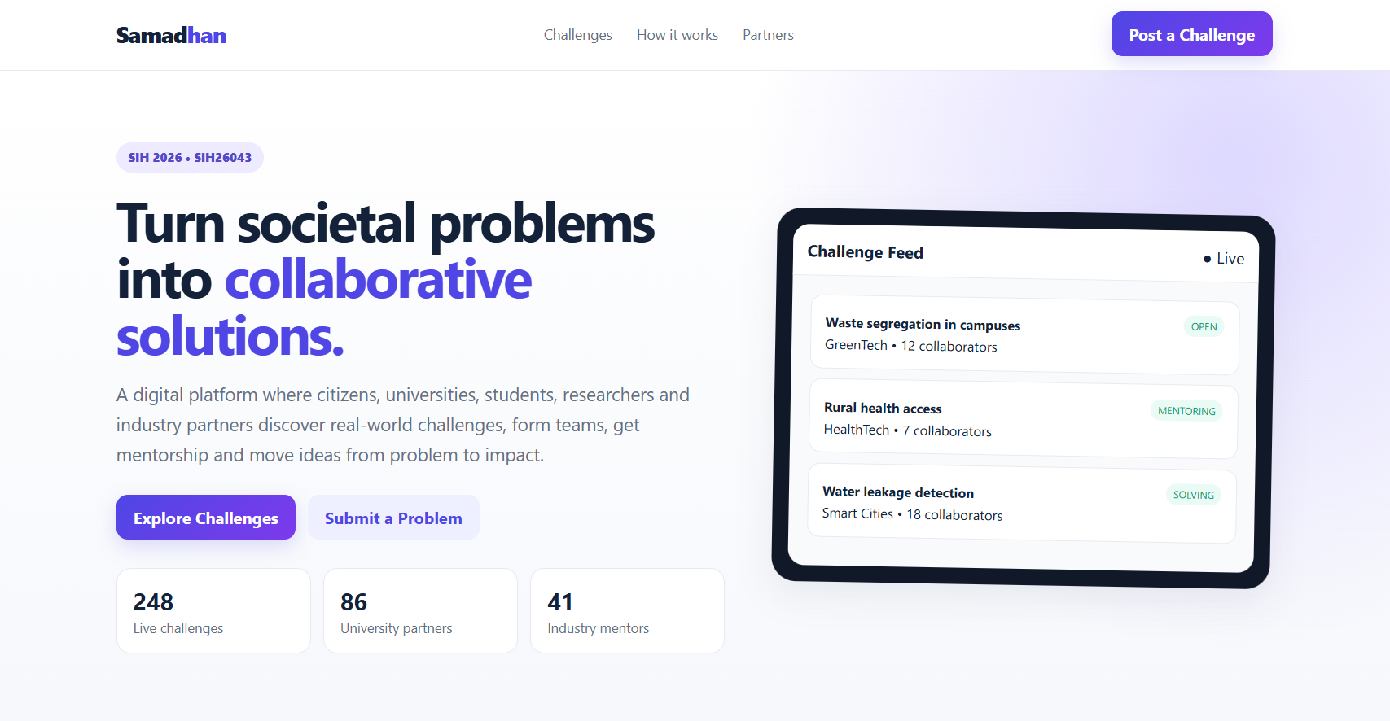
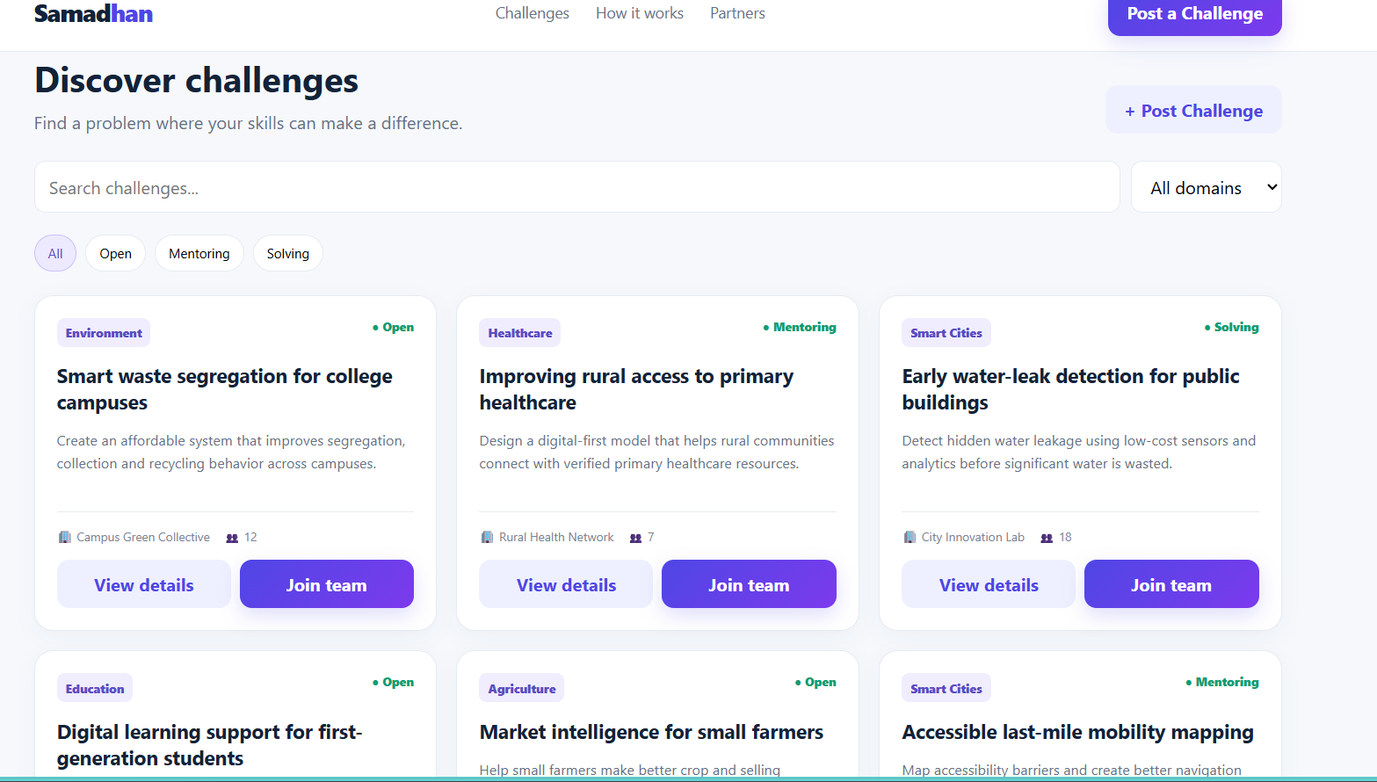
WORKING PROTOPYE

Slide 4
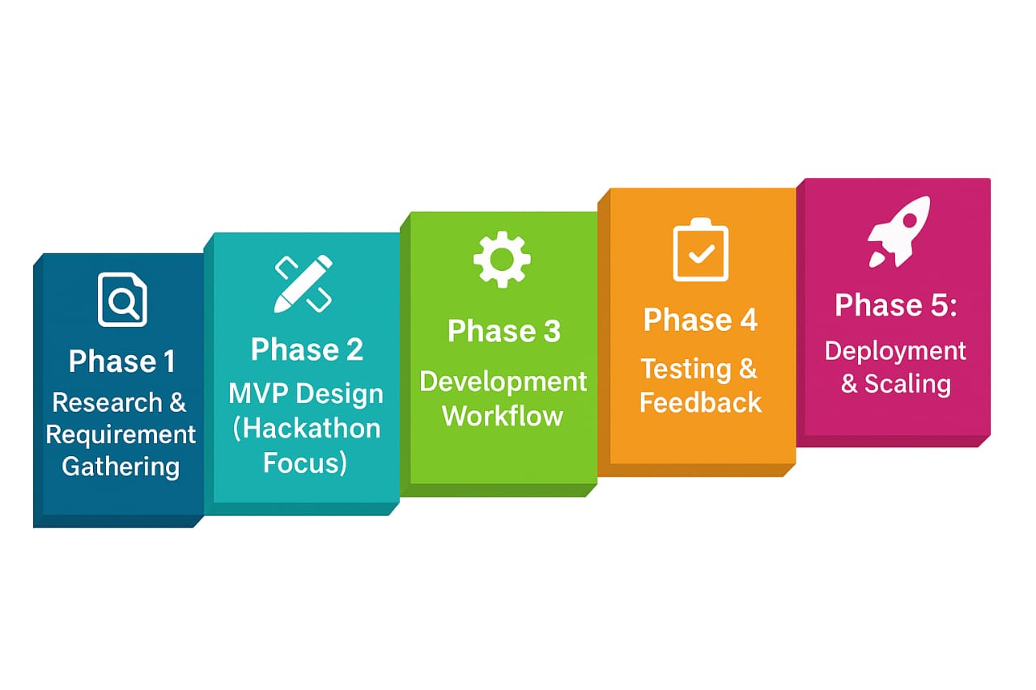
TECHNICAL APPROACH
Technologies to be used :-
User Flow :
COMMUNITY
│
↓
Submit Challenge
│
↓
Verification
│
↓
Smart Matching
│
┌─────┴─────┐
↓ ↓
UNIVERSITY INDUSTRY
│ │
↓ ↓
Form Team Find Project
│ │
└─────┬─────┘
↓
COLLABORATION
↓
PROTOTYPE
↓
PILOT
↓
DEPLOYMENT
↓
IMPACT
Research & Designing
Alumni & student database collection
Frontend Development
React.js (responsive web)
Flutter (cross-platform mobile)
Backend Development
Node.js + Express.js (APIs, integrations)
Firebase (cloud hosting & scaling)
Future Enhancements
AI/ML integration
Figma (prototyping & design)
Blockchain Credential Verification
Advanced Data Security & Privacy
Implementation Plan :

Slide 5
FEASIBILITY AND VIABILITY
Feasibility Analysis :
Technical
Operational
Economic
Legal & Ethical
Potential Challenges & Risks :
Data Collection & Verification
Privacy & Security
Technical Challenges
User participation
Solution quality
Strategies for Overcoming Challenges :
Challenge Verification
Smart Matching
Engagement System
Industry Participation
Project Monitoring

Slide 6
IMPACT AND BENEFITS
Potential Impact
societal
Inclusion
Accessibility
Mentorship
Educational
Innovation
Skill growth
collaboration
Industrials
Fundraising
employment
Deployment
Stronger bonds
Economical
Entrepreneurship
Scalability
Efficiency
Awareness
Benefits
of the Solution
Technological
Social
Cloud scalable
AI matching
Blockchain
Alumni
Community
Knowledge
Economic
Fundraising
Employability
Growth boost
Institutional
Rankings
Data insights
Credibility
Environmental
Digital-first
Virtual events
Low footprint

Slide 7
RESEARCH AND REFERENCES
1. Competitor Analysis
Vaave – CRM + fundraising (limited AI)
🔗 vaave.com
2. Industry Reports
QS Rankings – Alumni metric 🔗 topuniversities.com
THE Rankings – Reputation factor 🔗 timeshighereducation.com
NASSCOM / HolonIQ – EdTech trends
3. Technical References
LinkedIn API 🔗 learn.microsoft.com/linkedin
Twilio
🔗 twilio.com
SendGrid
🔗 sendgrid.com
4. Academic & Policy
Alumni Management Best Practices (Global case studies)
NEP 2020 (India) 🔗 education.gov.in/nep2020
Razorpay
🔗 razorpay.com
Stripe
🔗 stripe.com

